Slide 1

Advanced Marketing and Modeling
Arshia Gupta, Elias Ganal, Yaonan Lyu, Ziheng Qiu

Slide 2



Story Background
Automotive Industry Challenges
Developing new models involves significant time and financial investments.
Accurate prediction of consumer preferences is critical for success.
Market Insight
Traditional minivan users: Middle- to upper-middle-class families with multiple young children.
Emerging trend: Affluent families with 1–3 children showing interest in minivans.
Gap Identified
Dissatisfaction with bulky “tank-like” models.
Demand for a compact, luxury-oriented alternative.

Slide 3
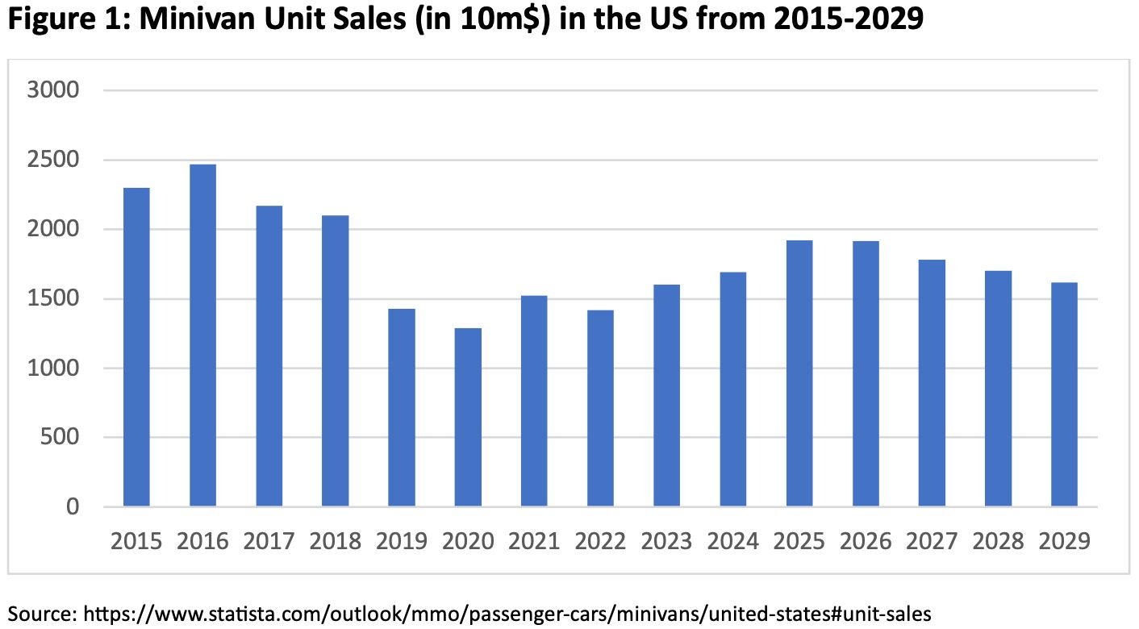
Market Trends
Stagnation and projected decline of traditional minivans (2015–2029).
Saturation due to lack of innovation and evolving consumer preferences.
Implications
Traditional minivans risk becoming obsolete without significant updates.
Urgent need for innovation to drive demand and engage new customer segments.

Slide 4
Research Objectives
Reduce the complexity of survey data while preserving key insights.
Provide clear, actionable findings to inform strategic decisions.

Slide 5
Our Approach
Clustering Analysis
Demographic Analysis
Dimensionality Reduction
Identify essential attributes driving preferences.
Group respondents into distinct customer segments.
Group respondents into distinct customer segments.

Slide 6

Data Quality
Data Collection Process:
Systematic and aligned with research objectives.
Pre-test survey refined questions; embedded in a broader survey to reduce bias.
Sampling:
Diverse U.S. adult panel with demographic representation (age, income, education).
Focused on relevant respondents with non-zero car purchase likelihood.
Sample size (400) adequate for exploratory analysis.
Survey Design:
Clear, unbiased questions based on focus group insights.
1–9 Likert scale enabled robust comparative and factor analyses.
Reliability & Validity:
Consistent data from standardized panel and psychometric scales.
Validity ensured through pre-testing and grounded question design.
Biases & Ethics:
Design minimized selection and attention biases.
Minor self-reporting bias mitigated by cross-referencing variables.
Ethical considerations adhered to; transparency about data usage could improve rigor.

Slide 7
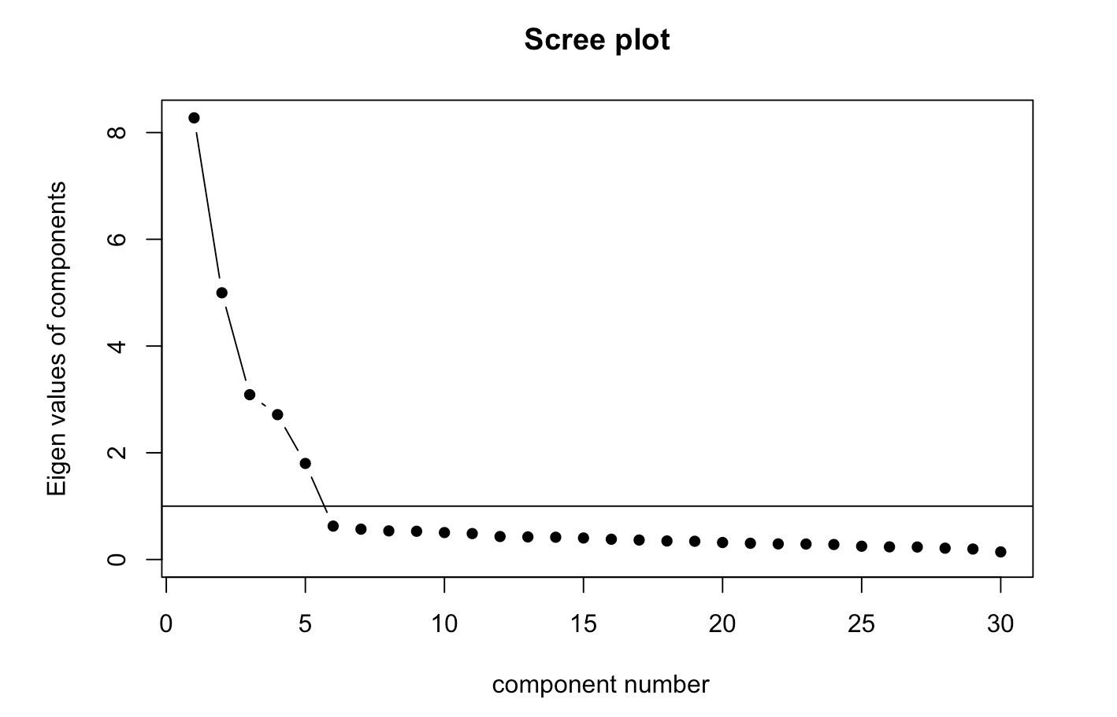
Dimensionality Reduction
Dimensionality Reduction using factor analysis:
Identify key variables while preserving insights.
Group similar patterns in responses.
Scree Plot shows eigenvalues dropping sharply after 4 factors.

Slide 8
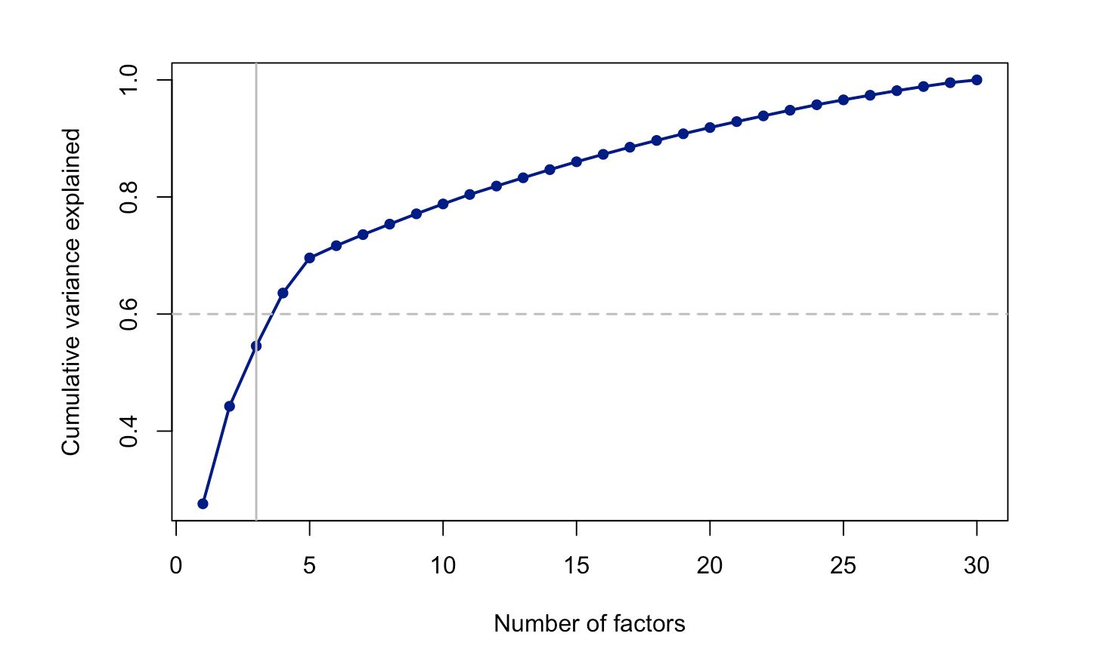
Pre-Analysis Steps:
Correlation Matrix: Many variables highly correlated.
Bartlett’s Test of Sphericity: p < 0.05, confirming data suitability.
KMO Measure: MSA = 0.92, indicating the dataset is "marvelous" for factor analysis.
Results:
Eigenvalues > 1: Retained 4 factors.
Variance Explained: 63.6% of total variance retained.
Cumulative Variance Plot highlights retained factors explaining >60% of variance.

Slide 9
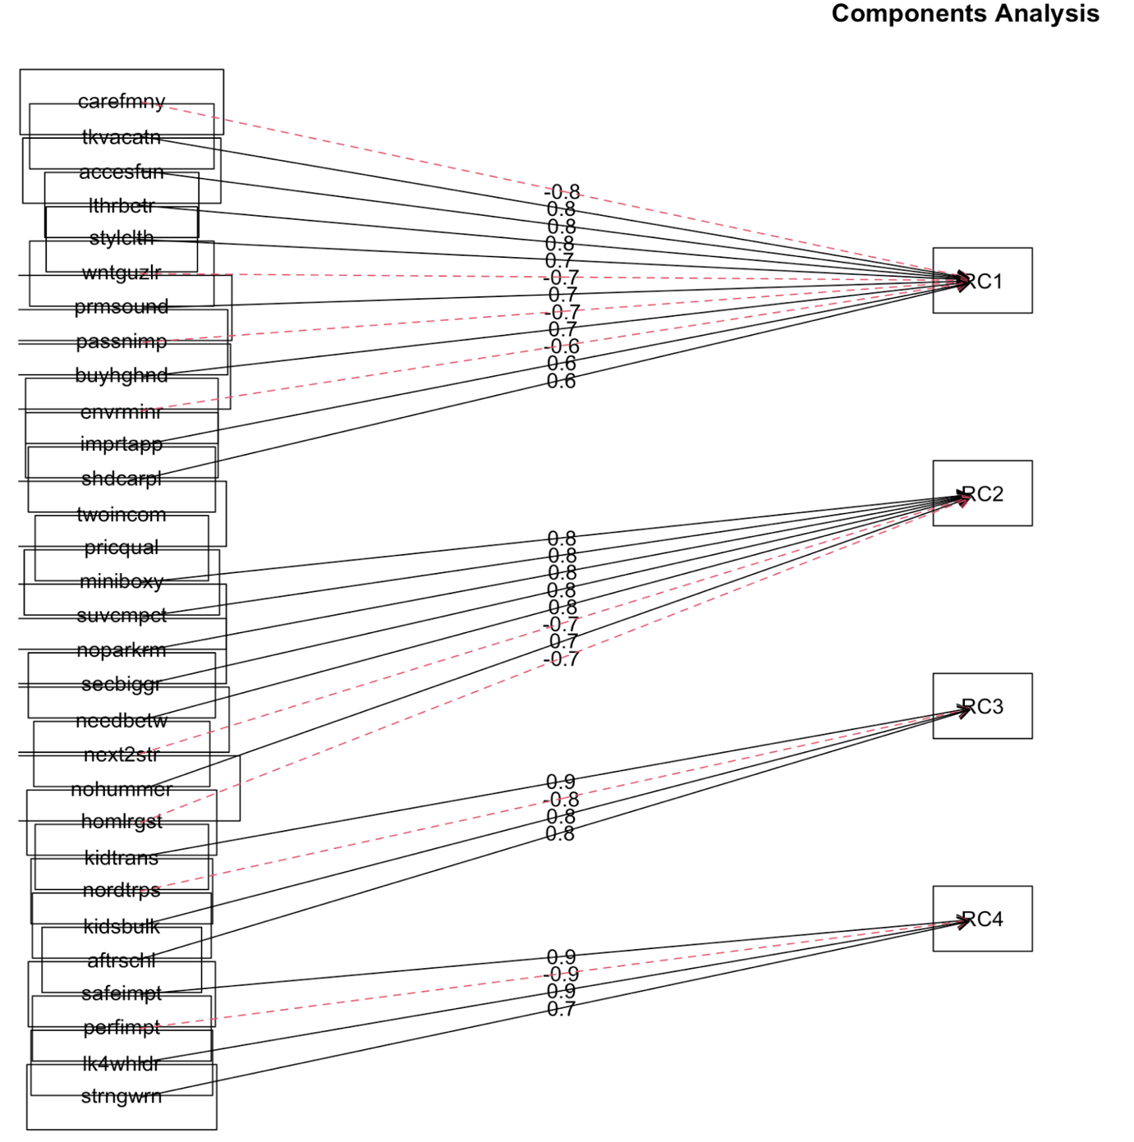
PCA-Based Factor Extraction
Factors and Their Interpretations:
Factor 1: Quality & Eco-Friendliness (12 variables)
Preferences for high quality and environmentally friendly features.
Factor 2: Novelty (8 variables)
Desire for innovation and new launches in the market.
Factor 3: Family (4 variables)
Focus on family needs, especially children.
Factor 4: Safety (4 variables)
Emphasis on vehicle safety.

Slide 10
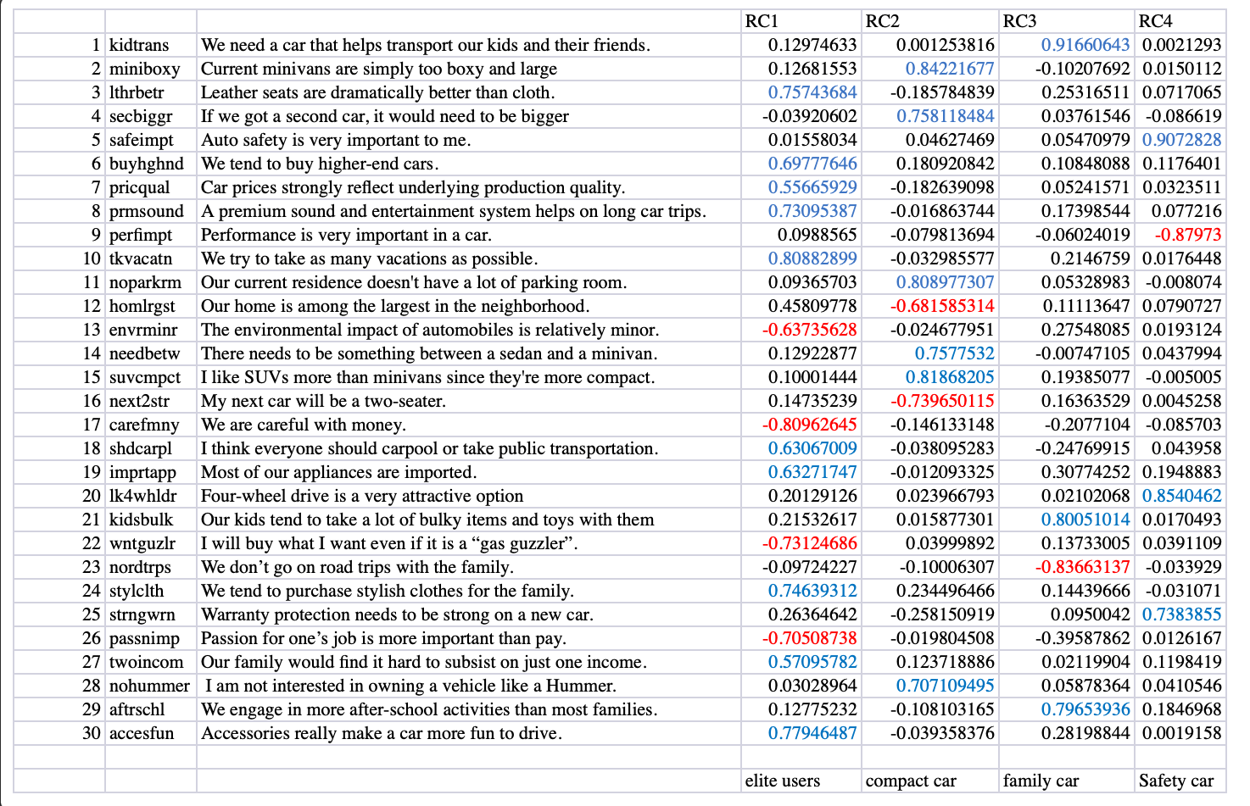

Slide 11
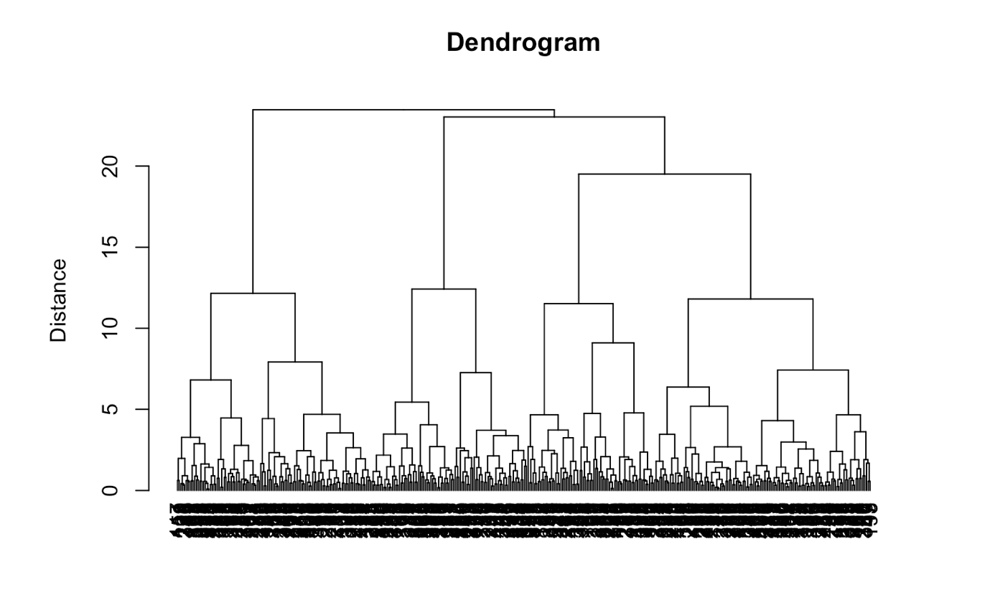
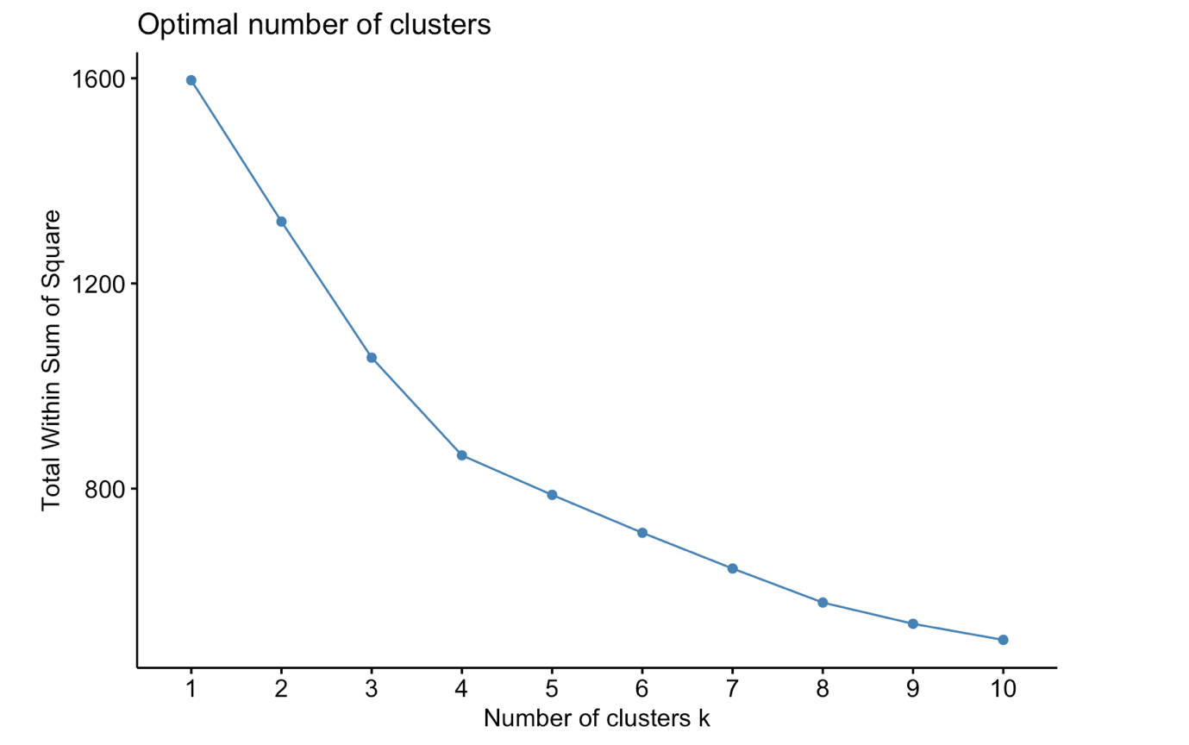
Clustering
Identify homogeneous customer sub-groups with distinct preferences for the microvan concept.
Methodology:
1. Hierarchical Clustering:
Dendrogram suggests 4–8 clusters as reasonable solutions.
2. K-Means Clustering (Elbow Method):
Optimal solution: 4 clusters.

Slide 12
Young Families (18.25%) Demographics: Avg. age: 38, income: $70,000, children: 1.75. Characteristics: Practical, performance-oriented, low focus on quality, eco-friendliness, and innovation. Marketing Strategy: Emphasize joyful family moments and trendy, cool design. Highlight performance capabilities to appeal to younger families.
Trendy Parents (22.5%) Demographics: Avg. age: 45, income: $85,000, children: 1.9. Characteristics: Strong focus on quality, eco-friendliness, and innovation; most aligned with the microvan concept. Marketing Strategy: Showcase high-quality craftsmanship, modern design, and eco-friendly features. Advertise as a stylish, innovative family vehicle for modern parents.
Traditionalists (28%) Demographics: Avg. age: 47, income: $105,000, children: 1.0. Characteristics: High value for quality and reliability, preference for traditional designs over innovation. Marketing Strategy: Position as a dependable, luxurious product. Highlight travel and adventure themes for older couples.
Apathetics (31.25%) Demographics: Avg. age: 30, income: $30,000, children: 0.5. Characteristics: Low interest in quality, eco-friendliness, and innovation. Marketing Strategy: Focus on themes of freedom and independence (optional). Ads featuring outdoor activities like camping, but consider deprioritizing this segment.
Clustering
Analysis

Slide 13
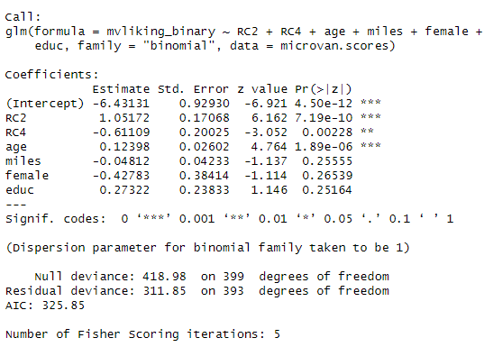
Logistic Regression
Assess how identified factors influence the likelihood of liking the microvan (dependent variable: mvliking).
mvliking transformed into a Binary Variable using the top 25% of responses (threshold: 7.5).
Model Development:
Baseline Model: Includes only an intercept for comparison.
Full Model: Includes all variables of interest.Variables RC1, RC3, income, numkids, recycle found to be statistically insignificant.
Final Model: Retains variables with high effect sizes (miles, female, education) despite insignificance at the 10% level.
Key Variables in Final Model:
RC2 (Preference for Compact Cars):
Odds Ratio (OR): 2.863 → Preference for compact cars increases odds of liking the microvan by 186.3%.
RC4 (Concern for Safety):
OR: 0.543 → Greater concern for safety decreases odds by 45.7%.
Final Model

Slide 14
Logistic Regression Analysis
Demographic Variables:
Age: Older individuals are more likely to like the microvan (OR = 1.132).
Female: Lower odds of liking (OR = 0.652) but statistically insignificant.
Education: Higher education increases odds (OR = 1.314) but is insignificant.
Insights for Marketing Strategy:
Target customers who prefer compact cars and are less focused on safety features.
Older individuals and those with higher education levels may be more inclined toward the microvan concept.

Slide 15


Conclusions and Recommendations
Key Segments:
Focus on Trendy Parents (modern, eco-friendly) and Traditionalists (luxury, reliability).
Young Families are a secondary target (practical, affordable features).
Product Positioning:
Premium designs with sustainable materials, modular interiors, and smart connectivity.
Tiered pricing to accommodate segment-specific needs and budgets.
Marketing Strategy:
Showcase family enjoyment, modernity, and eco-consciousness.
Highlight advanced safety tech and long-distance comfort to build trust.

Slide 16
Thank You

